Slide 1
House Price Prediction
Presented By
Sunanda Shil
Guided by
Sweta Bhadra

Slide 2
Contents
Objective
Introduction
Problem Statement
Proposed Methodology
Implementation
Result
Conclusion
Reference

Slide 3
Objective
For the buyers of real estate properties, an automated price prediction system can be useful to find under/overpriced properties currently on the market. This can be useful for first time buyers with relatively little experience, and suggest purchasing offer strategies for buying properties

Slide 4
Problem Statement
We need a proper prediction on the real estate and the houses in housing market. We have an mechanism that runs throughout the properties buying and selling a house will be a life time goal for most of the individual but there are lots of people making huge mistakes in INDIA right now. When buying the properties most of the people are buying properties unseen from the unknown people by seeing the advertisements which is very expensive but its not worth it.
In general, real estate may have the valuation of land may be obliged to furnish. A quantitative measure of the profit is carried out by many different Players in the commercial center, for example, land agents, lenders, brokers etc.

Slide 5
Introduction
Many methods have been used in the price prediction like a hedonic regression in this I am trying to predict the real estate price for the future using the machine learning techniques with the help of the previous works. I have used the linear regression, Decision tree regressor, Random Forest regressor algorithms with tools to predict the house price So, it would be helpful for the people, so they will aware of both current and future situations, so it may avoid them in making mistakes

Slide 6
Introduction
In general, the data parsed from raw HTML files may have mistakes both in the original record or initial processing. Outliers were determined by human inspection of the distribution of values, and subsequently removed/corrected. After data correction machine learning project, we predicted the selling prices of properties using regression methods such as linear regression. We predicted the asking price with rmse eg:- 3.16 using Random Forest regressor. We will present the details of the analysis, and the testing and validation results for better price detection. In addition, we will also discuss the significances of our approach and methodology.

Slide 7
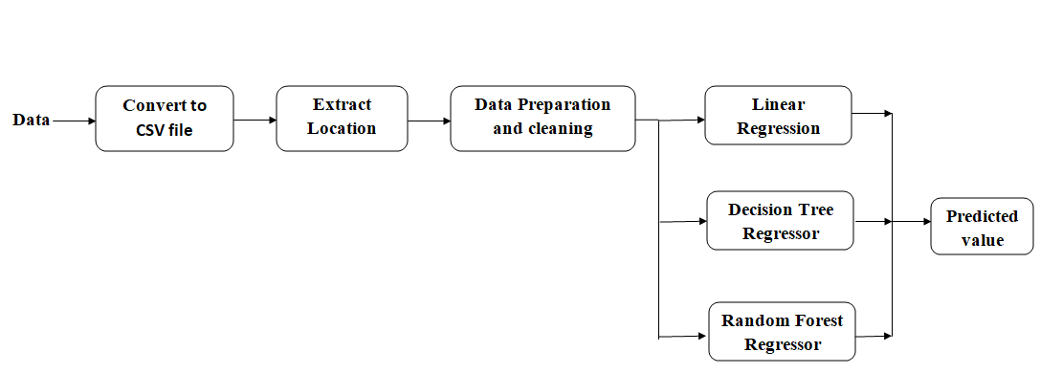
Proposed Methodology
Fig.1. Block Diagram of Proposed Methodology for House Price Prediction

Slide 8
Dataset Used
I am using Boston housing data
Boston housing data is very widely used for housing price prediction

Slide 9
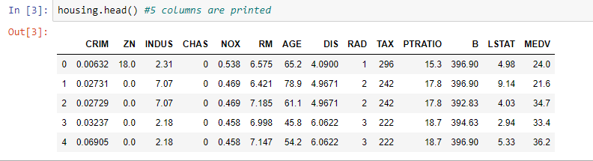
Implementation
Features Extracted
fig.2. Extracted data with value
Checking null value
Dataset divided into two part Train and Test

Slide 10
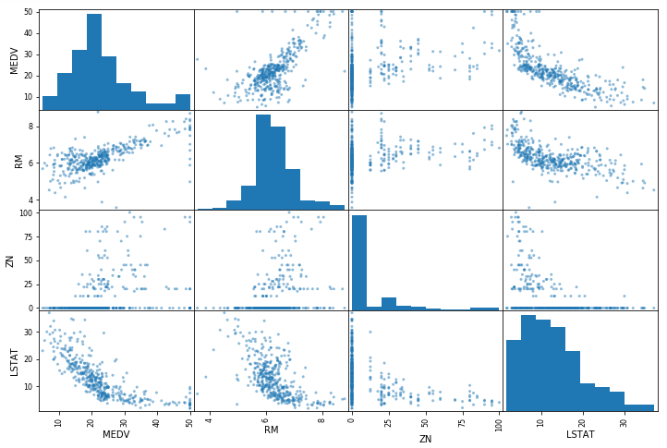
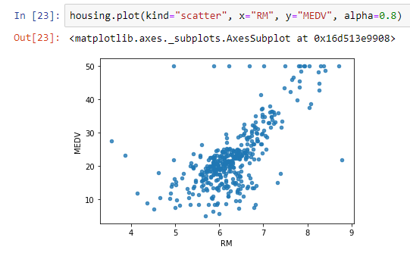
Implementation
Looking for correlation
Fig.3. Correlation plot

Slide 11
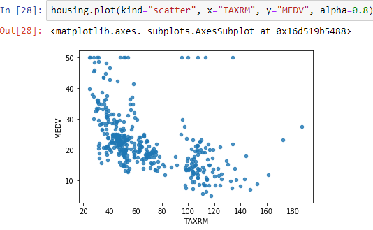
Implementation
Attribute Combination
fig.4. Attribute combination plot

Slide 12
Implementation
Creating Pipeline
Selecting the model (Machine Learning Algorithm)
1. Linear Regression
2. Decision Tree Regressor
3. Random Forest Regressor
Evaluating the model
Cross validation

Slide 13
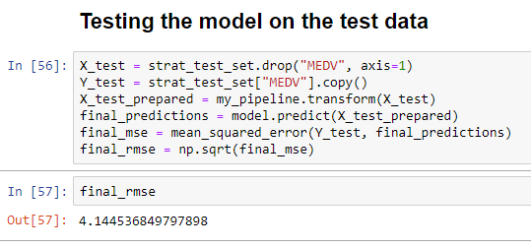
Result
Testing the model on test data
1. Linear regression
fig.5. Test rmse value

Slide 14
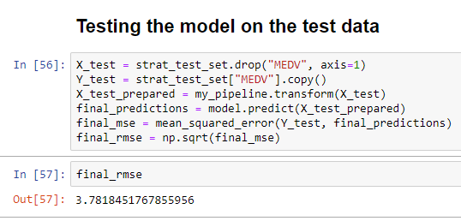
Result
Decision tree regressor
fig.6. Test rmse value

Slide 15
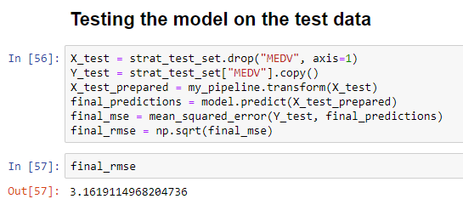
Result
Random Forest Regressor
fig.7. Test rmse value

Slide 16
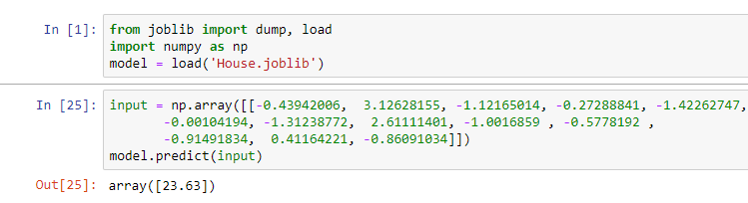
Result
Final prediction with the help of better model which is Random Forest Regressor

Slide 17
Conclusion
In this project, I focused on the prediction of house price which will be help for buyeer and seller.
I chose to implement the Regression model like Linear Regression, Decision tree and Random Forest Regressor out of three model Random Forest Regressor given better prediction (23.63 x 1000$)
I am able to achieve a good Prediction.

Slide 18
References
[1] GOV.UK. (2013) Property transactions in the UK. [Online]. Available: https://www.gov.uk/government/collections/property-transactions-in-the-uk
[2] London Data store. (2015) London Housing Market Report. [Online].Available: https://data.london.gov.uk/housingmarket/
[3] Nationwide. (2015) Nationwide House Price Index. [Online]. Available: https://www.nationwide.co.uk/~/media/Main Site/ documents/about/house-price-index/Q1_2015.pdf
[4] CEBR. (2015) UK house prices to decline this year, dragged down by as lump in London. [Online]. Available: http://www.cebr.com/reports/uk-house-prices-to-fall/
[5] A. White. (2015) London house prices to fall up to 5pc as sellers abandon the market. [Online]. Available: http://www.telegraph.co.uk/finance/property/11631377/London-asking-prices-jump-17pc-after-the-election.html
[6] ——. (2015) London asking prices jump 17pc after the election. [Online].Available: http://www.telegraph.co.uk/finance/property/11631377/London-asking-prices-jump-17pc-after-the-election.html
[7] Right move. (2014) House prices to rise 30pc by 2019, new Right move and Oxford Economics forecast reveals. [Online]. Available: http://www.rightmove.co.uk/news/articles/property-news/house-prices-to-rise-30-by-2019-new-rightmove-and-oxford-economics-forecast-reveals
[8] ——. (2015) House Price Index. [Online]. Available: http://www.rightmove.co.uk/news/house-price-index

Slide 19
THANK YOU

